Slide 1
Algorithm using GTN
By Tianyue Li

Slide 2
Table of Content
0 Review
1 Algorithm: Weighted Enumerative Top-down search
- user specification
- algorithm
- example
2 More explanation on Algorithm
- Initialization of Q
- inheritance mechanism
- weight calculating potential methods
3 More improvement on Abstract Semantics
- guidance in middle
- More on class N

Slide 3
Review
Last week, I put forward the GTN, the whole thing please refer to the doc below.
https://drive.google.com/file/d/1Nbt8Wq5EbYdYCAhJLnTfrWtYHIVA9gFM/view?usp=sharing

Slide 4
Algorithm: Weighted Enumerative Top-down search

Slide 5
User Specification
User input should includes:
A sequence of input tensors
An output tensor
The GTN relationship between each input tensor and the output tensor.

Slide 6
Algorithm 1: Weighted Enumerative Top-down search
- Algorithm
The algorithm’s picture is attached next slide.

Slide 7
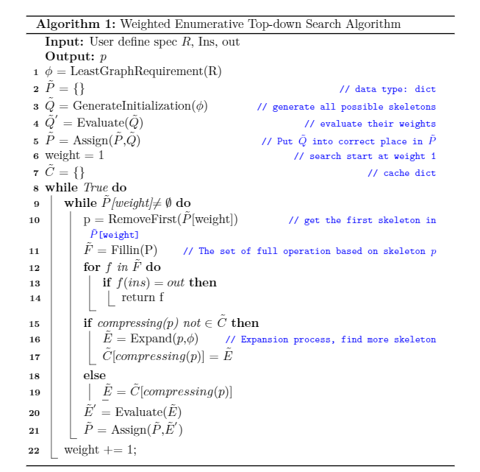

Slide 8
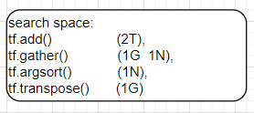
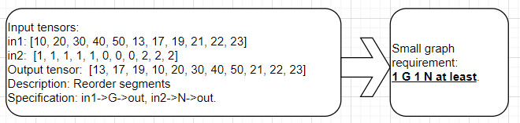
Algorithm 1: Weighted Enumerative Top-down search
-Example from TF-coder paper

Slide 9
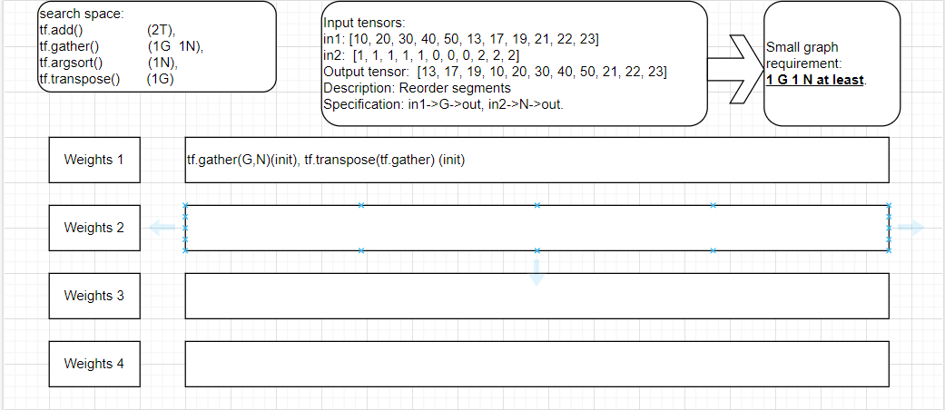
1 init the search set
1 try tf.gather(G,N), no result, expand it

Slide 10
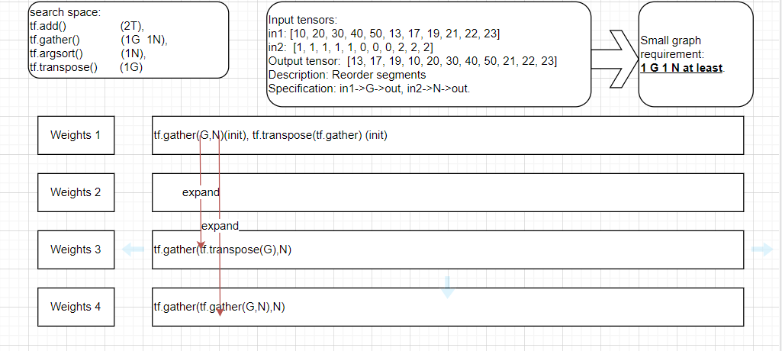
2 search on tf.gather(G,N)
Start from G

Slide 11
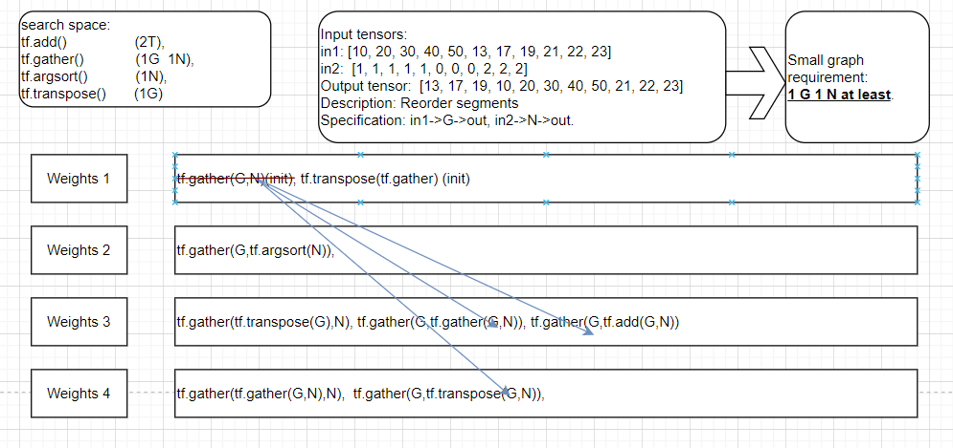
3 search on tf.gather(G,N)
Start from N, and remove tf.gather(G,N) after that.

Slide 12
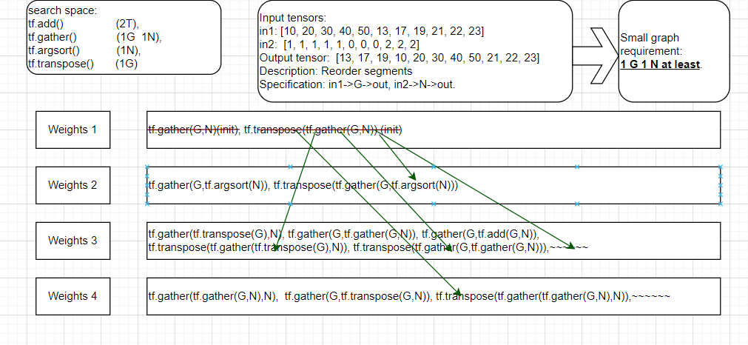
4 search on tf.transpose(tf.gather(G,N))
Inherent from tf.gather(), remove tf.transpose(tf.gather(G,N)) after that

Slide 13
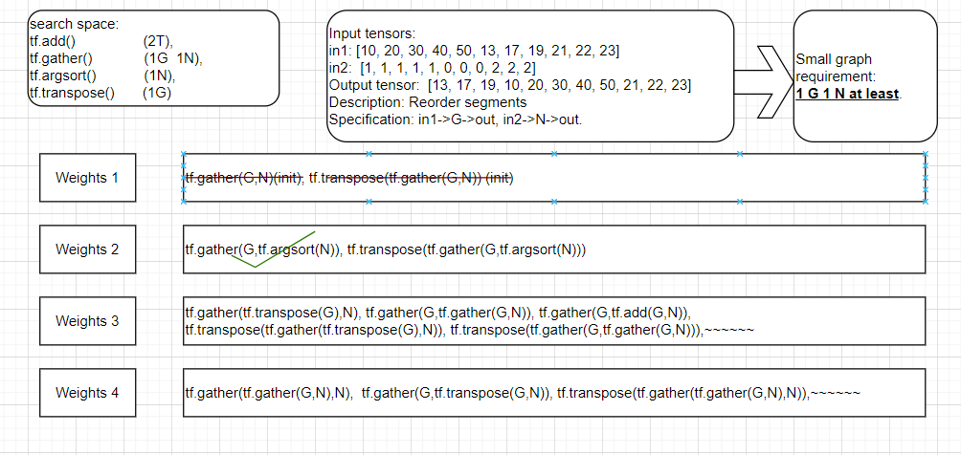
5 test on tf.gather(G,tf.argsort(N))
FIND SOLUTION 😀

Slide 14
More explanation on Algorithm 1

Slide 15
Initialization of Q
-method1 (used)
Method:
For the initialized un-filled query q should satisfy the “least graph requirement”, like “1G 1N” before. And all the possible smallest combinations should be considered,
Pros:
Good start of the program. Make things easier to handle during the search.
Cons:
Initialized set will be a large set when the search space is large. It can cause lot of time to generate them and evaluate them at the same time.

Slide 16
Initialization of Q
-method2 (improved)
Method:
Start only with potential single operation. Prioritize those operations that directly satisfy the user requirements. When the search reaches these operations not satisfying the “least graph requirements”, we can expand them to satisfy the requirements.
Pros:
Make the initialization set small. And can inherit from the previous search experience.
Cons:
Harder to handle.

Slide 17
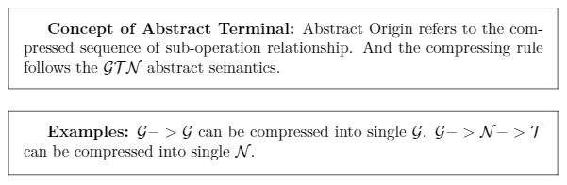

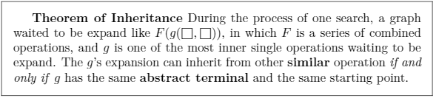
inheritance mechanism

Slide 18
3 More improvement on Abstract Semantics

Slide 19
Improvement on class N –reason
Note that the property of N makes the class G and class T lose their influence during the expanding process. Therefore, we need to find a way to either make these two classes keep their influence or make N less influential to them.

Slide 20
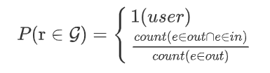
Improvement method 1: guidance in the middle
Note that the set N is a large set and it can sometimes cause the pruning less efficient when there are lots of N involved. We can add some guidance in the middle to utilize the G sub-operation relation.
Use
Use Above equation to calculate the distance between the output tensor and the false prediction.

Slide 21
Improvement on class N -method 2: divide the class N
Actually, another method which I prefer is to divide the class N into more sub-classes which are at the same level of importance. For example, we can get class I, which represents the indexing operation, and the class S, which represents the shaping operation. Then, these two classes should have the same level of importance, making the abstract semantics below:
I->S = S (since S is the last)
G->I = I (same as N)
I->G = I …

